Slide 1

Structural Pattern: Adapter：
00

Slide 2

Structural Pattern: Adapter
Overview
The adapter pattern implementation decouples card structure from effect behavior, unifies effects through the IEffect interface, enables flexible effect composition via dynamic adapters, and supports adding new effects/cards without modifying existing code.
Issue Before Refactoring
1. Cards and effect logic were tightly coupled with code duplication
2.Adding new effects required modifying existing cards, violating the open-closed principle
3.Effect implementations were inconsistent, lacking a common interface
4.Complex effect combinations were difficult, with high maintenance costs

Slide 3
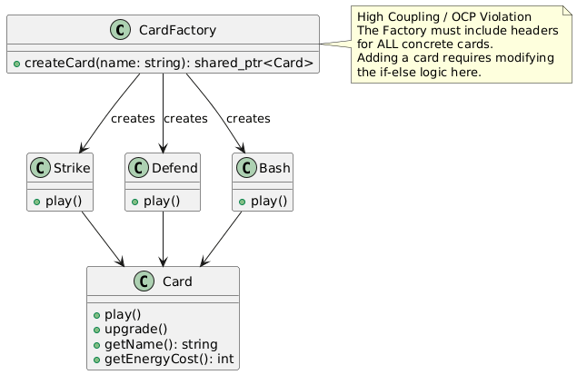
Structural Pattern: Adapter
UML Changes
Before

Slide 4
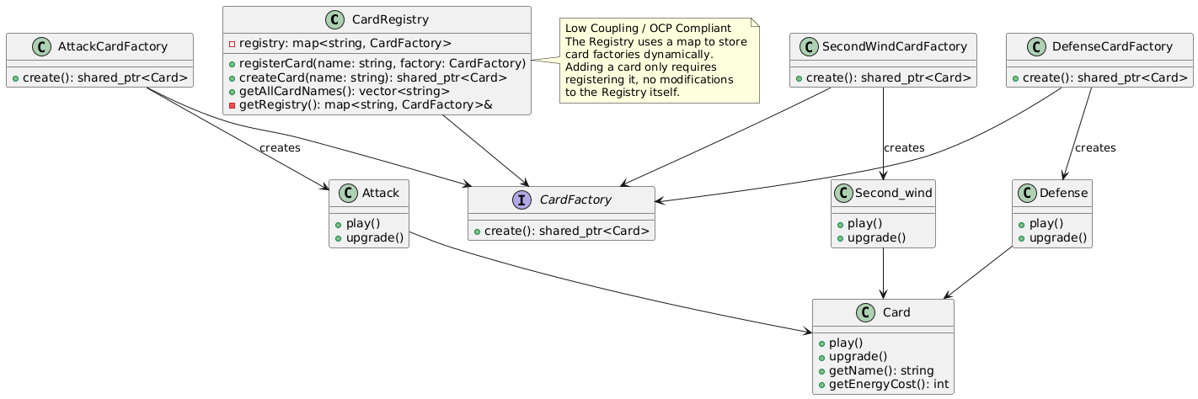
Structural Pattern: Adapter
UML Changes
After
Refactor Overview
1.Separated card and effect logic
2.Used IEffect interface to unify effect implementations
3.Cards combine functions by adding effect adapters

Slide 5
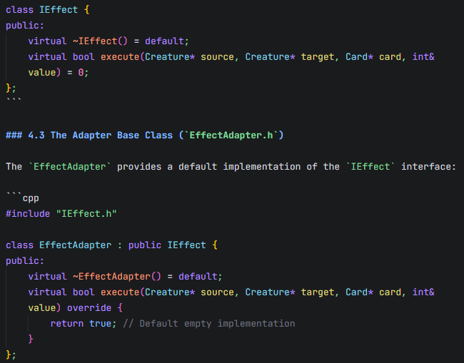
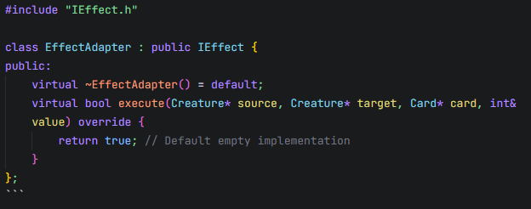
Structural Pattern: Adapter
Detailed implementation
1. The `IEffect` interface
2. The Adapter Base Class

Slide 6
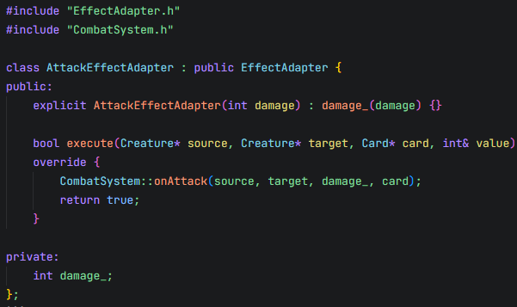
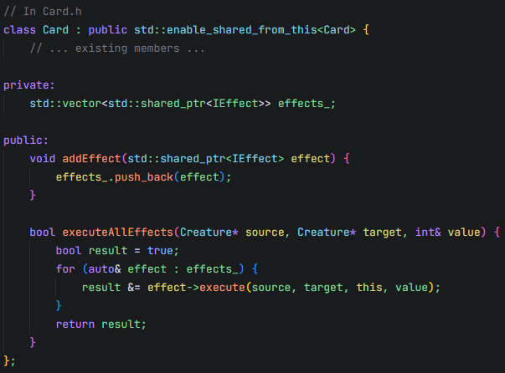
Structural Pattern: Adapter
Detailed implementation
3. Concrete Adapters
4. Updated Card Class

Slide 7
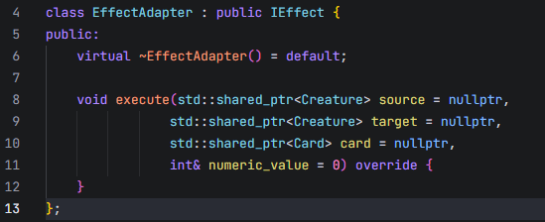
Structural Pattern: Adapter
Advantages
Future Extensions
1 Extensibility
New effects can be added by creating new adapter classes without modifying existing card code.
2 Decoupling
Separates concrete effect implementations from card classes, reducing direct dependencies between components.
3 Easy Testing
Effect adapters can be tested independently of card classes, improving testability and reducing test complexity.
Adding a new effect type now requires 0 changes to existing cards. You simply create a new adapter class inheriting from IEffect and implement the execute() method.

